Slide 1
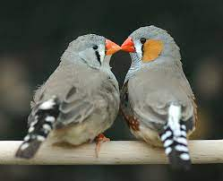
Circadian Activity Analysis
BIOL 792
Cassandra Hui

Slide 2
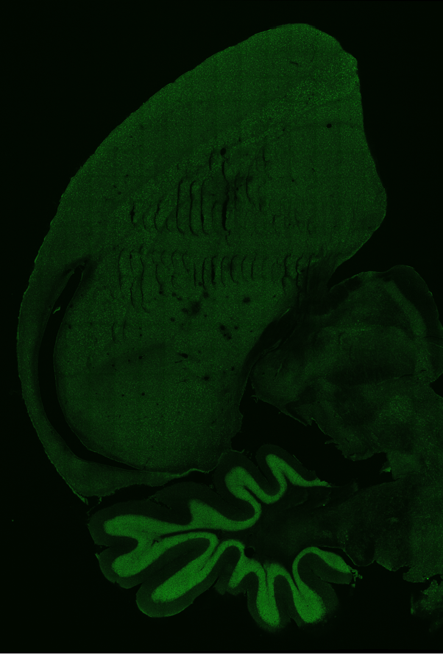
Effects of Artificial Light at Night
Artificial light at night negatively impacts health and physiology
We want to determine neural pathways activated by night light
Used Zebra Finches to stain for immediate early genes, cFos and ZENK, indicative of neural activation to novel stimuli
Additionally, we collected activity data to look at circadian rhythms

Slide 3
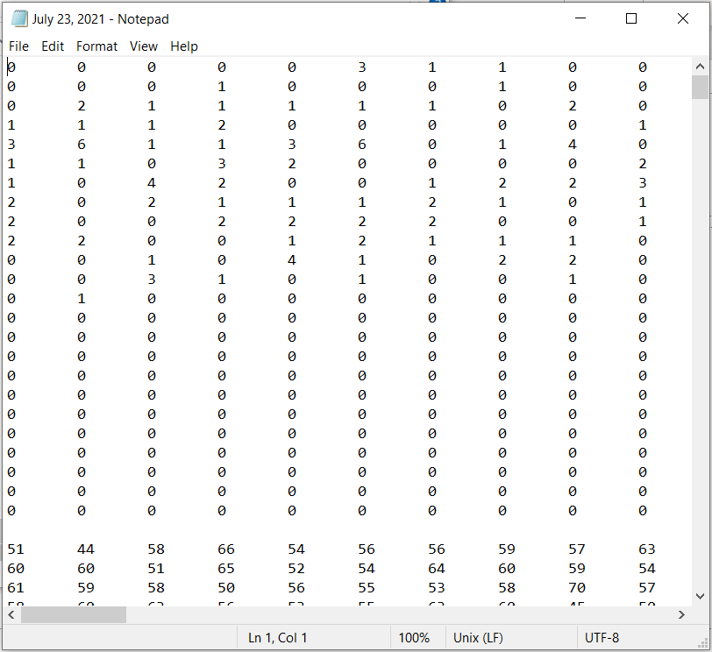
Data Output
Hop data is recorded from perches
Different file for each day
Columns are minutes
Rows are hours
Birds separated by an empty line

Slide 4
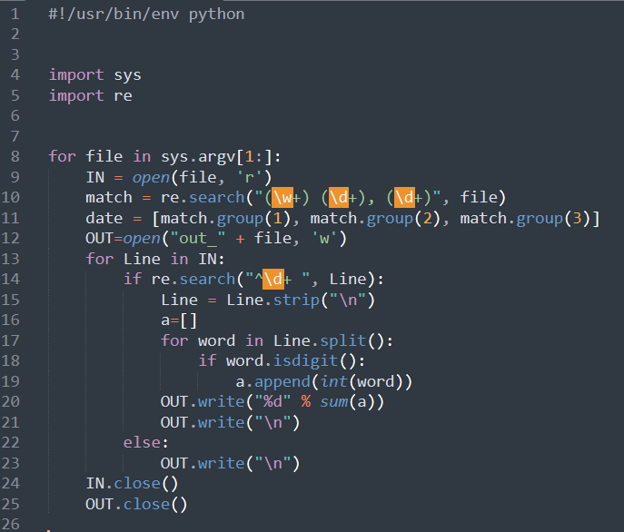
Code to Sum Minutes
Turn all numbers into digits and add them into a list
Each line is the sum of all minutes

Slide 5
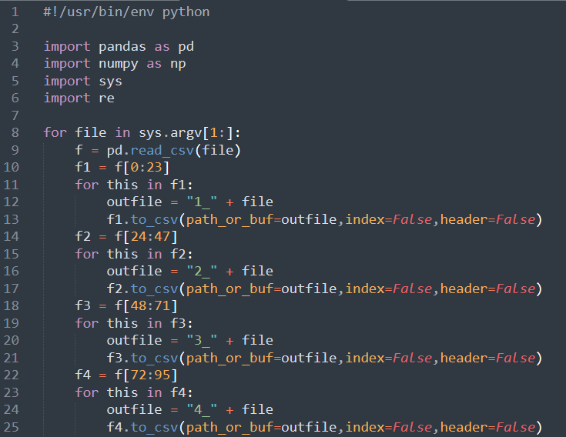
Code to Separate Birds
Separating each bird’s activity into separate files by date

Slide 6
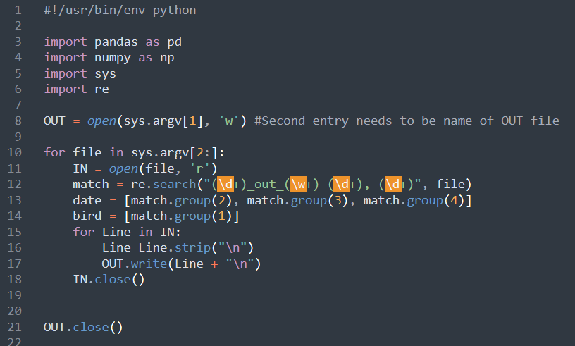
Adding Individual Birds Together
Adding all the dates together for each bird
Output is one file for each bird with all activity
Second Unix input needs to be the name of the out file

Slide 7
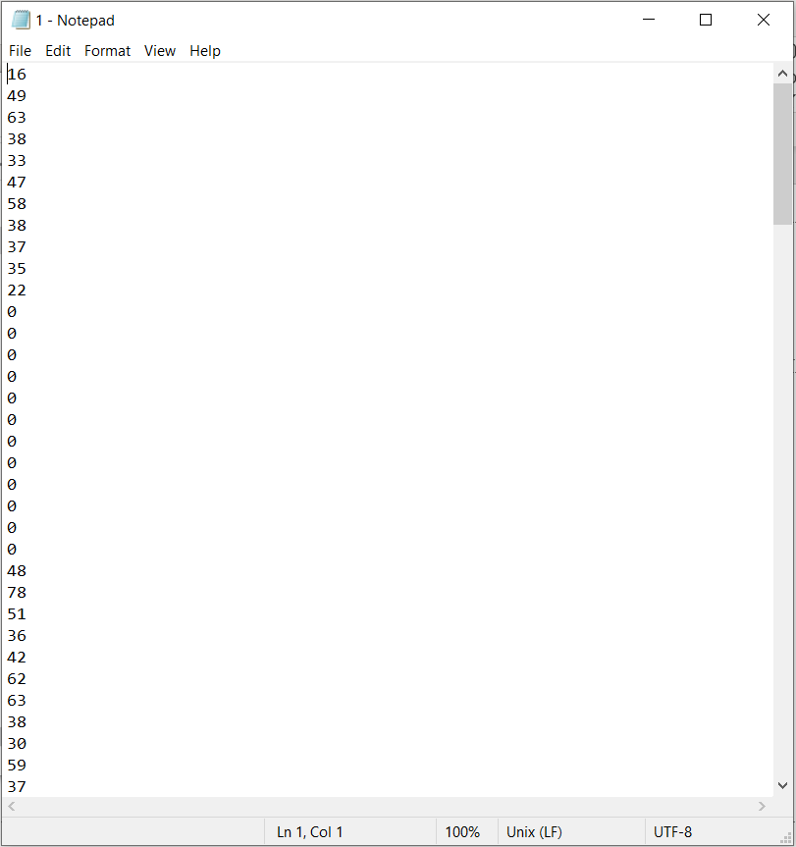
Output File

Slide 8
